Slide 1
70-530 Data Visualization
Week 1 - Introduction

Slide 2
Outline
Course Overview and Requirements
Motivation for Data Visualization
Visualization Stages
Model of Perceptual Processing
Classifications of Visualizations
Design Considerations
Tools of the Trade

Slide 3
Course Overview and Requirements

Slide 4
Course Description
Course Number and Name
70-530, Data Visualization
Catalog Course Description
The theory and practice of visualizing large, complicated data sets to clarify areas of emphasis. Human factors best practices will be presented. Programming with advanced visualization frameworks and practices will be demonstrated and used in group programming projects.

Slide 5
Learning Objectives
Explain how the human brain processes visual information and how to design based on that.
Select the best ways to present a given data set.
Write software that presents data in a particular way and that enables the user to interact with it in ways that improve understanding.
Present data to peers in intuitive, instructive ways.

Slide 6


Required Textbooks
Visualizing Data: Exploring and Explaining Data with the Processing Environment 1st Edition. Ben Fry. 978-0596514556
Designing Data Visualizations. Julie Steele and Noah Iliinsky. 978-1449312282

Slide 7

Optional Textbook
(optional) Information Visualization: Perception for Design (Interactive Technologies) 3rd Edition, Colin Ware, 978-0123814647

Slide 8

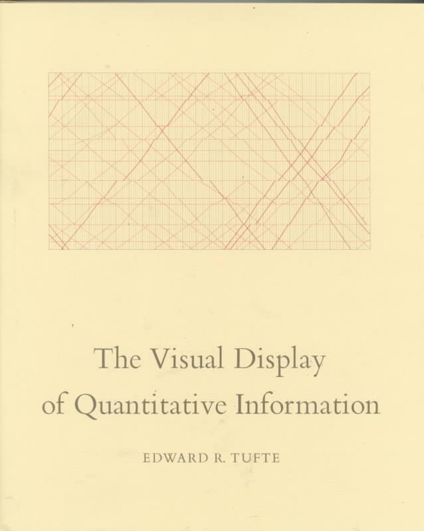


Other Good Books on Visualization
Notes:
Beautiful Visualization: Looking at Data through the Eyes of Experts (Theory in Practice)
http://www.amazon.com/exec/obidos/ASIN/1449379869/braipick-20
The Visual Display of Quantitative Information by Edward R. Tufte
-classic
Communicating Data with Tableau 1st Edition
-very good reviews
-communication theory and examples in tableau
Interactive Data Visualization for the Web (D3 book)
http://chimera.labs.oreilly.com/books/1230000000345/index.html

Slide 9
Course Requirements
You will be required to do the following each week:
Attend the live session and/or watch recorded lecture videos.
Read the textbooks and any secondary readings.
Complete visualization projects (due on selected weeks).
Complete a quiz with questions related to the material for that week.
Answer a discussion question related to the reading and reply to another student's post.

Slide 10
Due Dates
Discussions: Initial posts due Thursday by 11:59PM CST; all follow-up posts due Saturday by 11:59PM CST.
Quizzes: Due Sunday by 11:59PM CST.
Final Exam: Due Sunday by 11:59PM CST of Week 8.
Projects: Due Sunday by 11:59PM CST on selected weeks (see Course Schedule, below).

Slide 11
Evaluation and Grading
Your course grade will be based on the following requirements:

Slide 12
Discussion Questions
Answer a question or comment on a topic based on some research or readings.
You will be required to post this to the corresponding forum in BlackBoard.
Answers should be complete, detailed, and make use of examples or references when appropriate.
1 point for a satisfactory posting; 1 for reply to another student's post. (max 2)
NOTE: you will not see postings of other students until you make a post yourself.

Slide 13
Quizzes
Given in weeks 1 through 7.
About 5 multiple choice, true/false, or fill-in-the-blank type questions based on readings and lectures for that week.
20 minutes for each quiz.
Each quiz is worth the same
Each question within each quiz is worth the same
3 attempts for each quiz, but you will not see any answers until the due date of the quiz has passed.
Your grade will be calculated based on the maximum score among the three attempts.

Slide 14
Visualization Projects
Due on selected weeks (see Course Schedule)
Produce a visualization of a dataset and communicate your findings with a written report.
2 individual and 3 group projects
Each assignment is worth the same
Grading based on the rubric given in the assignment description.

Slide 15
Final Exam
Given in week 8.
25 questions based on all quizzes and any material covered up to the time of the final exam.
120 minutes
Each question is worth the same number of points.
Only 1 attempt

Slide 16
Letter Grades
The final course letter grade will be determined from the numeric weighted average grade using the following scale:
A 94-100 C 74-76
A- 90-93 C- 70-73
B+ 87-89 D+ 67-69
B 84-86 D 64-66
B- 80-83 D- 60-63
C+ 77-79 F 59 and below

Slide 17
Late Policy
The expectation is that you submit all assignments by the due date.
Late assignments will not be accepted unless there are special circumstances that have been discussed with your instructor.

Slide 18
Academic Dishonesty
Note on cheating:
Basically - don’t do it.
Any instance of cheating (plagiarism or other) will result in a zero grade for the work or even an F grade for the course!
Copying text or code or letting someone copy is considered cheating. You must cite any references you use.

Slide 19
Course Outline
Week 1: Overview
Week 2: Design Principles
Week 3: Encodings
Week 4: Interactive Visualizations
Week 5: Time Series
Week 6: Connections, Correlations, and Scatterplot maps
Week 7: Trees and Networks
Week 8: Trees and Networks (cont.)

Slide 20
Motivation for Data Visualization

Slide 21
Data Visualization as a Science
Data Visualization:
art ???
science ???
pseudo-science ???

Slide 22
Foundations for a Science of Data Visualization
Cognition and learning:
interaction between people using cognitive tools: pencils and paper, calculators, software, …
Since beginning of time, science relied on:
diagrams, mathematical notations, and writing have been essential tools of the scientist
Now we have powerful analytic tools:
MATLAB, Maple, Python, Weka, SAS, …
Cognitive system theory
Visualizations have a small but crucial and expanding role in cognitive systems.

Slide 23
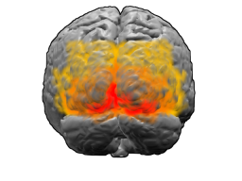
Visualizations for Humans
Visual displays provide the highest bandwidth channel from the computer to the human.
We acquire more information through vision than through all of the other senses combined.
20 billion neurons of the brain devoted to analyzing visual information provide a pattern-finding mechanism
Notes:
that is a fundamental component in much of our cognitive activity.

Slide 24
Motivation for Visualizations
Improving cognitive systems:
tightening the loop between a person, computer-based tools, and other individuals
We have two things:
Human visual system - great at pattern recognition
World Wide Web and other informational resources + computing power
Visualization is the link between these two

Slide 25
Visualization - Meaning
Visualization used to mean constructing a visual image in the mind (Shorter Oxford English Dictionary, 1972)
Now means:
A graphical representation of data or concepts
Visualization became an external artifact supporting decision making

Slide 26
Advantages of Visualization
Big advantage of visualization:
sheer quantity of information that can be rapidly interpreted if it is presented well

Slide 27
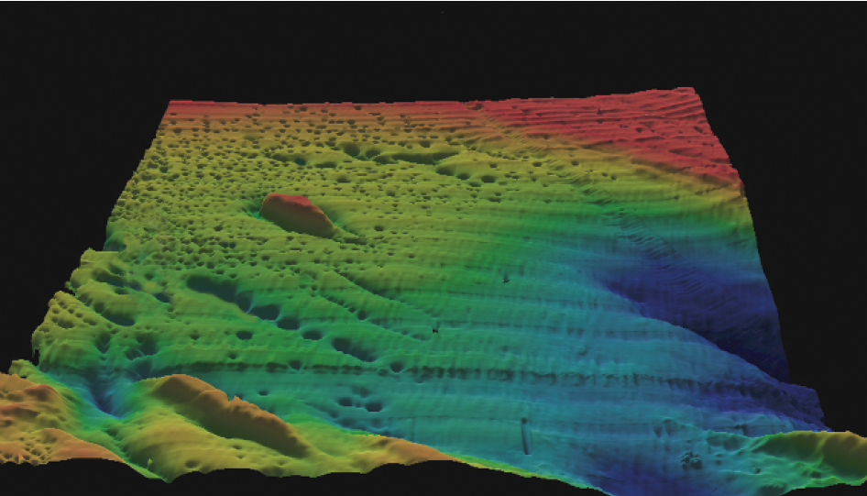
Advantages of Visualization
Example: Passamoquoddy Bay visualization
Notes:
shows a visualization derived from
a multibeam echo sounder scanning part of Passamoquoddy Bay, between Maine, in the United
States, and New Brunswick, Canada, where the tides are the highest in the world. Approximately
one million measurements were made. Traditionally, this kind of data is presented in the form
of a nautical chart with contours and spot soundings. However, when the data is converted to a height field and displayed using standard computer graphics techniques, many things become
visible that were previously invisible on the chart. A pattern of features called pockmarks can
immediately be seen, and it is easy to see how they form lines. Also visible are various problems
with the data. The linear ripples (not aligned with the pockmarks) are errors in the data because
the roll of the ship that took the measurements was not properly taken into account.

Slide 28
Advantages of Visualization
The Passamoquoddy Bay image highlights a number of the advantages of visualization:
Provides an ability to comprehend huge amounts of data.
Allows the perception of emergent properties that were not anticipated.
Often enables problems with the data itself to become immediately apparent.
Facilitates understanding of both large-scale and small-scale features of the data.
Visualization facilitates hypothesis formation

Slide 29
Semiotics
Visualization: science or a "learned language" ?
Generally, diagrams are held to be made up of symbols, and symbols are based on social interaction.
The study of symbols and how they convey meaning is called semiotics.
Discipline originated by C.S. Peirce (USA)
Later developed in Europe by the French philosopher and linguist Ferdinand de Saussure (1959).

Slide 30
Principle of Arbitrariness
Saussure defined a principle of arbitrariness as applying to the relationship between the symbol and the thing that is signified.
Truth is relative to its social context
Meaning in one culture may be nonsense in another
Example: a trash can as a visual symbol for deletion is meaningful only to those who know how trash cans are used.

Slide 31

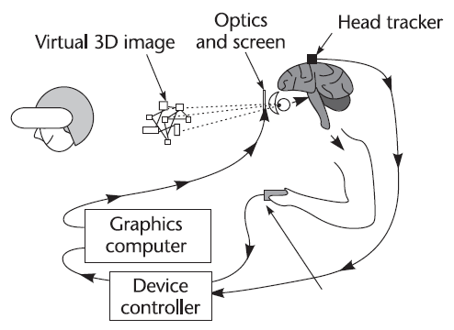
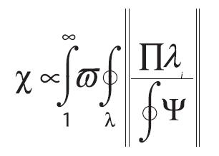
Three Graphics - Are They Visualizations???
Notes:
Three graphics. Each could be said to be a visualization.

Slide 32
Arbitrariness in Pictures
Pictures can also be thought of as context-sensitive
Argument - there is similarity to real things
Counter-argument - Nelson Goodman (1968):
Realistic representation, in brief, depends not upon imitation or illusion or information but upon inculcation. Almost any picture may represent almost anything; that is, given picture and object there is usually a system of representation—a plan of correlation—under which the picture represents the object.

Slide 33
Arbitrariness in Pictures
Studies support the idea that people can interpret pictures without training
Deregowski (1968):
Reported studies of adults and children, in a remote area of Zambia, who had very little graphic art.
Despite this, these people could easily match photographs of toy animals with the actual toys.

Slide 34
Arbitrariness in Pictures
Hochberg and Brooks (1962):
Raised their daughter nearly to the age of two in a house with no pictures.
Thus, she had no social input telling her that pictures had any kind of meaning.
When the child was finally tested, she had a reasonably large vocabulary, and she was asked to identify objects in line drawings and in black-and- white photographs.
Despite her lack of instruction in the interpretation of pictures, she was almost always correct in her answers.

Slide 35
Arbitrariness in Pictures
The most probable explanation is that at some stage in visual processing, the pictorial outline of an object and the object itself excite similar neural processes (Pearson et al., 1990).
Plausible due to ample evidence that one of the most important products of early visual processing is the extraction of linear features in the visual array.
These may be either the visual boundaries of objects or the lines in a line drawing.

Slide 36
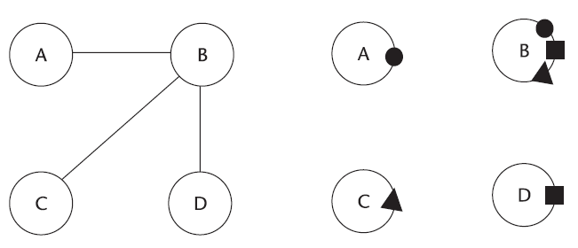
Arbitrariness in Pictures
Even though we can interpret without training, conventions still matter, e.g.:

Slide 37
Sensory vs Arbitrary Symbols
Sensory symbols: symbols and aspects of visualizations that derive their expressive power from their ability to use the perceptual processing power of the brain without learning
Arbitrary symbols: representations that must be learned, because the representations have no perceptual basis
(e.g., word dog bears no perceptual relationship to any actual animal)
Few visualizations use purely sensory or arbitrary symbols

Slide 38
Sensory Representations
Sensory representations are effective
well matched to early stages of neural processing
tend to be stable across individuals, cultures, and time.
Conversely, arbitrary conventions derive their power from culture and are therefore dependent on the particular cultural milieu of an individual.

Slide 39
Theory of Sensory Languages
Initially, brain was thought to be tabula rasa (blank slate) - adaptable to any environment
Now we know brain is highly specialized for our environment
like a collection of highly specialized parallel processing machines with high-bandwidth interconnections
designed to extract information from the world in which we live, not from some other environment with entirely different physical properties

Slide 40
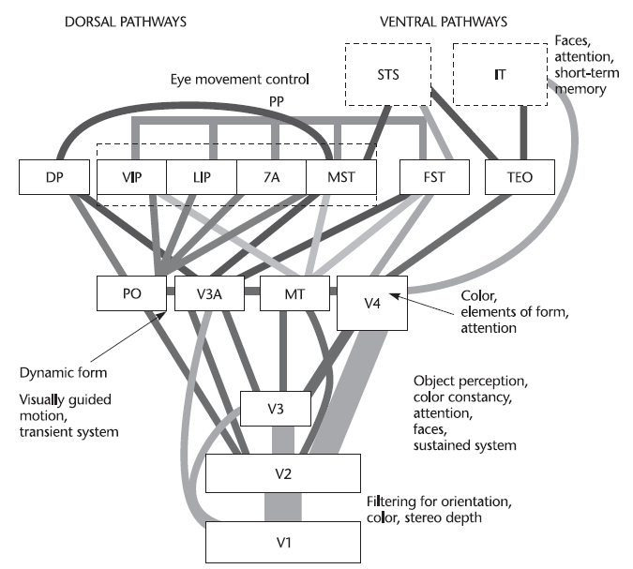
Major visual pathways of the Macaque monkey
Notes:
The major visual pathways of the Macaque monkey. This diagram is included to illustrate the structural
complexity of the visual system. Adapted from Distler et al. (1993); notes added. V1–V4, visual areas 1–4; PO,
parieto-occipital area; MT, middle temporal area (also called V5); DP, dorsal prestiate area; PP, posterior
parietal complex; STS, superiotemporal sulcus complex; IT, inferotemporal cortex.

Slide 41
Visual Systems
Macaque monkeys, cats, and humans have similar visual systems
Same type of environments
Same laws of physics (light, gravity, …)
Verified in experiments and observations (fMRI, PET, brain injury effects)

Slide 42
Sensory vs. Arbitrary Visualizations
Sensory representations
studied in sensory neuroscience
can also make claims that transcend cultural and racial boundaries
Arbitrary representations
studied in structuralist social sciences

Slide 43
Properties of Sensory and Arbitrary Representations
Understanding without training: A sensory code is one for which the meaning is perceived without additional training.
Resistance to instructional bias: Many sensory phenomena, persist despite the knowledge that they are illusory.
Sensory immediacy: The processing of certain kinds of sensory information is hard-wired and fast.
Cross-cultural validity: A sensory code will, in general, be understood across cultural boundaries.

Slide 44
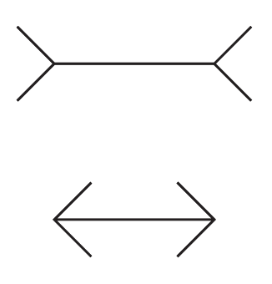
Representations can be misleading
Notes:
Despite knowledge of illusion, the effect still persists. This shows some processing is hard-wired into the brain.

Slide 45

Representations can be misleading

Slide 46
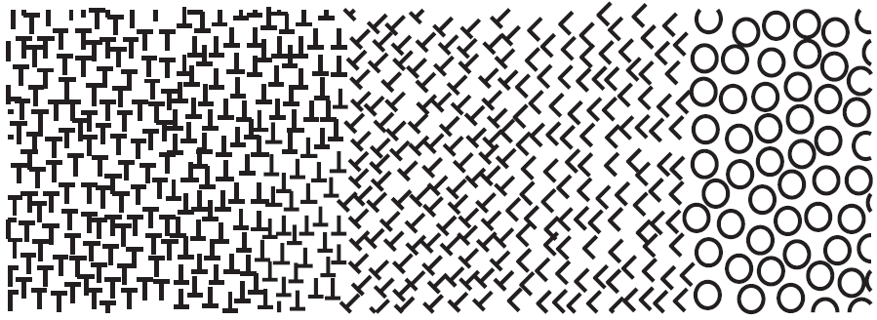
Representations can be misleading
Notes:
Five textures - vert/horz T is hard to differentiate. Oblique T is easy to differentiate from inverted T. Circles are easiest to differentiate.

Slide 47
Arbitrary Representation Characteristics
Hard to learn: It takes a child hundreds of hours to learn to read and write, even if the child has already acquired spoken language.
Easy to forget: Arbitrary conventional information that is not overlearned can easily be forgotten.
Embedded in culture and applications: meaning of colors red vs. green
Formally powerful: Arbitrary graphical notations can be constructed that embody formally defined, powerful languages.
Capable of rapid change: One way of looking at the sensory/arbitrary distinction is in terms of the time the two modes have taken to develop.

Slide 48

Arbitrary Representation Characteristics
Which column has the most stocks going up?
Shanghai stock market board
Notes:
Shanghai stock market board - red means price went up.
Which column has the most stocks going up? - third (not second)
In China, Red is associated with good fortune, Green with death.

Slide 49
Affordance Theory
J.J. Gibson (1979) - Gibson’s Affordance Theory
Perception is designed for action
We perceive in order to operate on the environment.
affordances - perceivable possibilities for action
we perceive these properties of the environment in a direct and immediate way.
This theory is clearly attractive from the perspective of visualization, because the goal of most visualization is decision making.
Thinking about perception in terms of action is likely to be much more useful than thinking about how two adjacent spots of light influence each other’s appearance

Slide 50
Affordance Theory
Clearly attractive from the perspective of visualization, because the goal of most visualization is decision making.
Thinking about perception in terms of action is likely to be much more useful than thinking about how two adjacent spots of light influence each other’s appearance

Slide 51
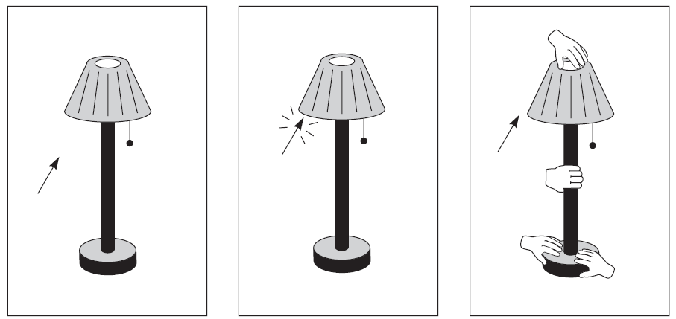
Affordances Example
Notes:
Small drawings of hands pop up to show the user what interactions are possible in the prototype
interface.

Slide 52
Affordance Theory Problems
Claim perception is direct; however, drawing visualization is indirect (many layers, steps) - need to know how to implement those
No clear physical affordances in any graphical user interface (should an icon be pressed? should a "button" be pressed?)
Rejects knowledge of visual mechanisms
Still useful for design considerations.

Slide 53
Visualization Stages

Slide 54
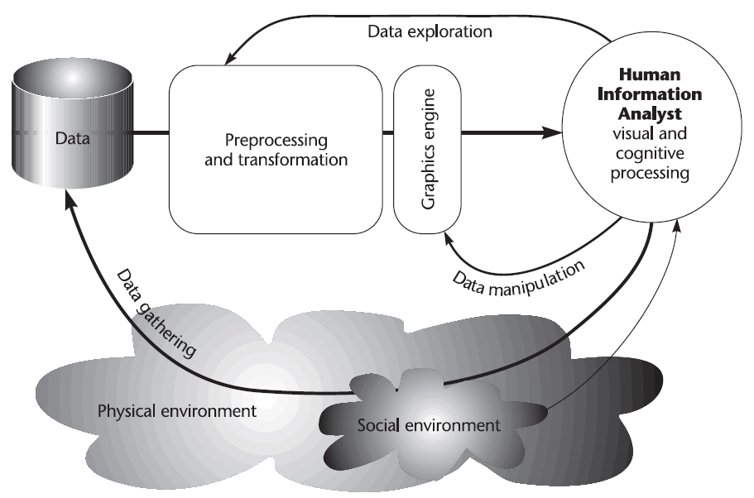
Visualization Stages - Diagram
Notes:
The process of data visualization includes four basic stages, combined in a number of feedback
loops.

Slide 55
Visualization Stages
4 stages of visualization:
The collection and storage of data itself
The preprocessing designed to transform the data into something we can understand
The display hardware and the graphics algorithms that produce an image on the screen
The human perceptual and cognitive system (the perceiver)

Slide 56
Visualization Stages
Longest feedback loop: gathering data.
A data seeker, such as a scientist or a stock-market analyst, may choose to gather more data to follow up on an interesting lead.
Both the physical environment and the social environment are involved in the data-gathering loop.
The physical environment is a source of data, while the social environment determines in subtle and complex ways what is collected and how it is interpreted.

Slide 57
Visualization Stages
Another loop controls the computational preprocessing that takes place prior to visualization.
The analyst may feel that if the data is subjected to a certain transformation prior to visualization, it can be persuaded to give up its meaning.

Slide 58
Visualization Stages
Visualization process itself may be highly interactive.
For example, in 3D data visualization, the scientist may fly to a different vantage point to better understand the emerging structures.
Alternatively, a computer mouse may be used interactively, to select the parameter ranges that are most interesting.

Slide 59
Model of Perceptual Processing

Slide 60
Model of Perceptual Processing
Simplified information-processing model of human visual perception
Stage 1: information is processed in parallel to extract basic features of the environment.
Stage 2: active processes of pattern perception pull out structures and segment the visual scene into regions of different color, texture, and motion patterns.
Stage 3: the information is reduced to only a few objects held in visual working memory by active mechanisms of attention to form the basis of visual thinking.

Slide 61
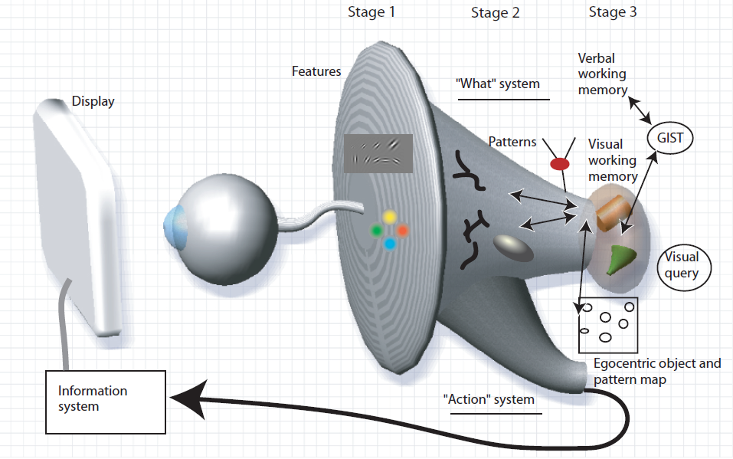
Three-stage Model of Perception
Notes:
3-stage model of perception

Slide 62
Three-stage Model of Perception
Stage 1: Visual information is first processed by large arrays of neurons in the eye and in the primary visual cortex at the back of the brain.
Individual neurons are selectively tuned to certain kinds
of information, such as the orientation of edges or the color of a patch of light.

Slide 63
Three-stage Model of Perception
Stage 1 characteristics:
Rapid parallel processing
Extraction of features, orientation, color, texture, and movement patterns
Transitory nature of information, which is briefly held in an iconic store
Bottom-up, data-driven model of processing

Slide 64
Three-stage Model of Perception
Stage 2: rapid active processes divide the visual field into regions and simple patterns,
such as continuous contours, regions of the same color, and regions of the same texture.
(also - patterns of motion)
-like a "feature map"

Slide 65
Three-stage Model of Perception
Tasks involving eye–hand coordination and locomotion may be processed in pathways distinct from those involved in object recognition.
Two–visual system hypothesis:
one system for locomotion and action, called the “action system,”
and another for symbolic object manipulation, called the “what system.”

Slide 66
Three-stage Model of Perception
Stage 2 characteristics:
Slow serial processing
Involvement of both working memory and long-term memory
More emphasis on arbitrary aspects of symbols
In a state of flux, a combination of bottom-up feature processing and top-down attentional mechanisms
Different pathways for object recognition and visually guided motion

Slide 67
Three-stage Model of Perception
Stage 3: objects are held in visual working memory by the demands of active attention.
In order to use an external visualization, we construct a sequence of visual queries that are answered through visual search strategies.
At this level, only a few objects can be held at a time; they are constructed from the available patterns providing answers to the visual queries.
For example, if we use a road map to look for a route, the visual query will trigger a search for connected red contours (representing major highways) between two visual symbols
(representing cities).

Slide 68
Types of Visualizations

Slide 69
Types of Visualizations
The key function of data visualization is to move information from point A to point B.
Two types:
In exploratory visualization, point A is the dataset and point B is the designer’s own mind.
In explanatory visualization, point A is the mind of the designer, and point B is the mind of the reader.

Slide 70
Visual Communication
To cross between points A and B and be successfully communicate, the information must be encoded for transmission.
Visual elements are the chosen transmission medium.
Designer’s purpose in designing a data visualization is to create a deliverable that will be well received and easily understood by the reader.
All design choices and particular implementations must serve this purpose.

Slide 71
Classifying Data Visualizations
Can classifying by complexity metric:
number of data dimensions represented
(i.e., number of discrete types of information that are visually encoded in a diagram)
Examples:
a simple line graph may show the price of a company’s stock on different days: that’s two data dimensions.
If multiple companies are shown (and therefore compared), there are now three dimensions;
if trading volume per day is added to the graph, there are four.

Slide 72
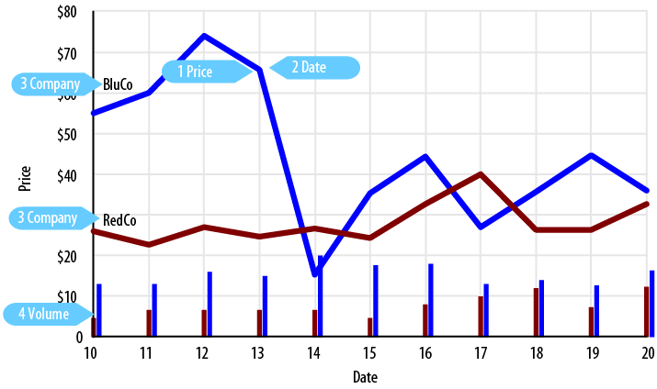
Data Dimensions
Graph with 4 data dimensions.
Notes:
Four data dimensions are shown in this graph. Adding more points within any of these
dimensions won’t change the graph’s complexity.

Slide 73
Data Dimensions
Each data dimension is associated with individual visual property
High number of dimensions are difficult to visualize
Designer needs to be intentional about which property
to use for each dimension, and iterate or change encodings as the design evolves

Slide 74
Data Visualization vs. Infographics
Distinction between data visualization and infographics
Infographics are:
Manually drawn
Specific to the data at hand
Aesthetically rich
Relatively data-poor

Slide 75
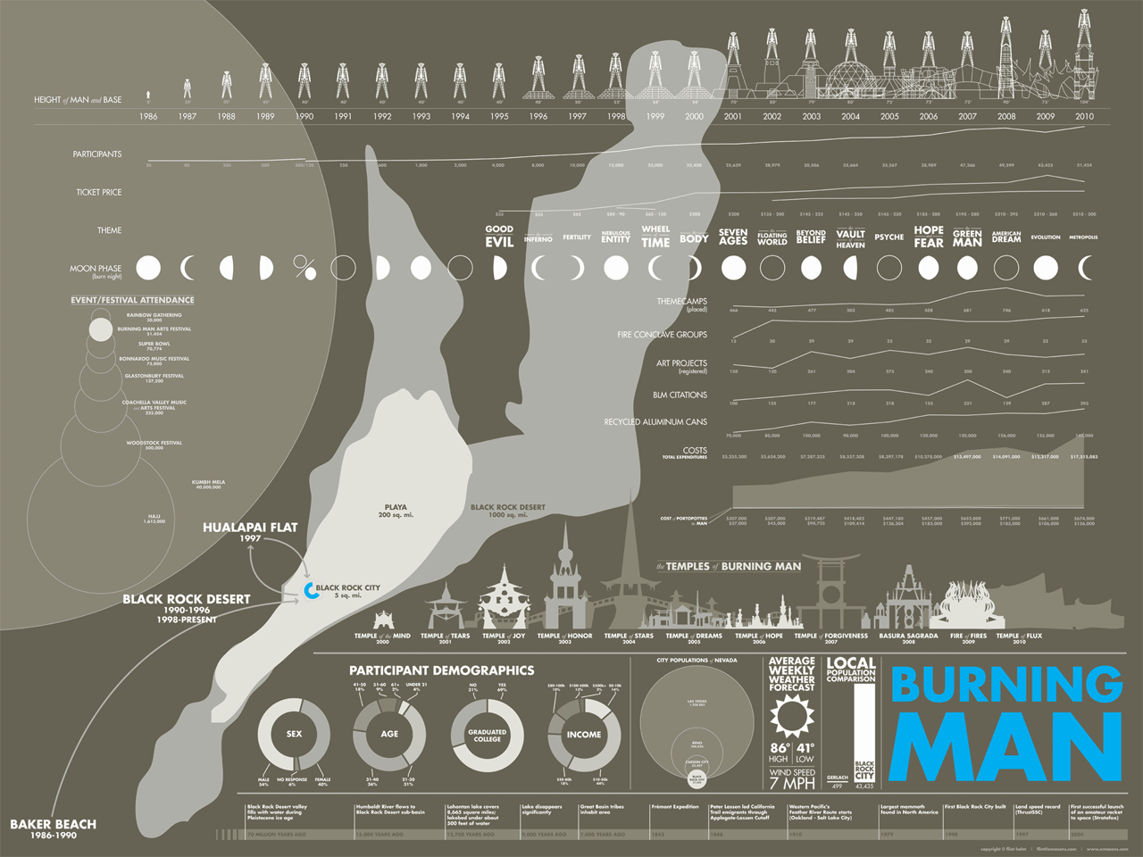
Flint Hahn’s Burning Man infographic
Notes:
is a great example of an aesthetically rich,
manually-drawn piece.

Slide 76
Data Visualization vs. Infographics
Data visualizations are:
Algorithmically drawn
Easy to regenerate with different data
Often aesthetically barren
Relatively data-rich

Slide 77
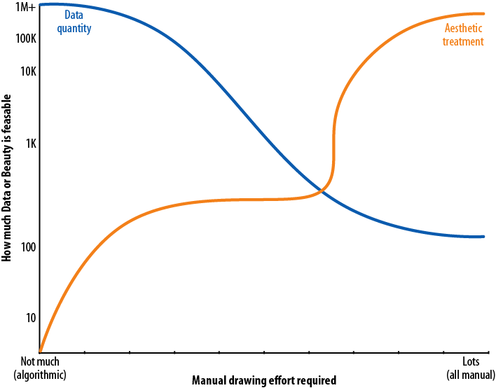
Data Visualization vs. Infographics
Notes:
The difference between infographics and data visualization may be loosely determined by
the method of generation, the quantity of data represented, and the degree of aesthetic treatment
applied.

Slide 78
Exploration vs. Explanation
Exploratory data visualizations are appropriate when you have a whole bunch of data and you’re not sure what’s in it.
Best done at a high level of granularity.
This type of visualization is typically part of the data analysis phase, and is used to find the story the data has to tell you.

Slide 79
Exploration vs. Explanation
Explanatory data visualization is appropriate when you already know what the data has to say, and you are trying to tell that story to somebody else.
You’ll need to make certain editorial decisions about which information stays in, and which is distracting or irrelevant and should come out.
This is a process of selecting focused data that will support the story you are trying to tell.
Part of presentation stage.

Slide 80
Exploration vs. Explanation
Hybrid exploration/explanation visualization:
Involves a curated dataset that allows some exploration on reader's part
Has been distilled and facilitated to some extent
Usually interactive

Slide 81
Informative vs. Persuasive vs. Visual Art
3 main categories of explanatory visualizations based on the relationships between the three necessary players:
the designer
the reader
the data

Slide 82
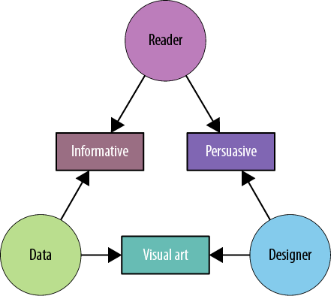
Informative vs. Persuasive vs. Visual Art
Notes:
The nature of the visualization depends on which relationship (between two of the three
components) is dominant.

Slide 83
Informative vs. Persuasive vs. Visual Art
Informative visualization primarily serves the relationship between the reader and the data.
Aims for a neutral presentation of the facts in such a way that will educate the reader.
Often associated with broad data sets, and seek to distill the content into a manageably consumable form.

Slide 84
Informative vs. Persuasive vs. Visual Art
Persuasive visualization primarily serves the relationship between the designer and the reader.
Useful when the designer wishes to change the reader’s mind about something.
Represents a very specific point of view, and advocates a change of opinion or action on the part of the reader.
Data represented is specifically chosen for the purpose of supporting the designer’s point of view, and is presented carefully so as to convince the reader of same. (Note: could be considered propaganda.)

Slide 85
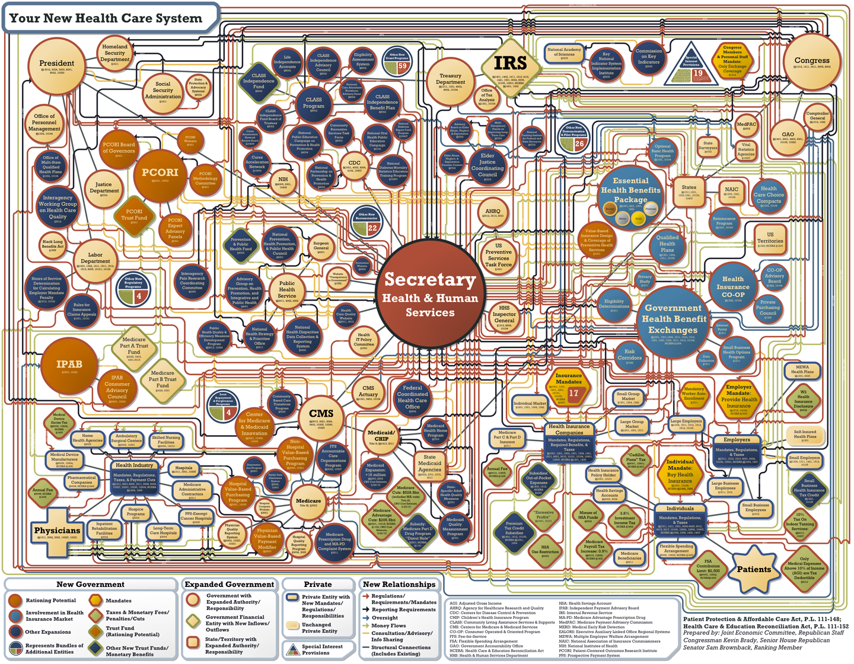
Notes:
Persuasive visualization aiming to show (exaggerate) the complexity of the health care system

Slide 86
Informative vs. Persuasive vs. Visual Art
Visual art, primarily serves the relationship between the designer and the data.
Often entails unidirectional encoding of information
Different than both informative and persuasive visualizations - those are meant to be easily decodable—bidirectional in their encoding
Visual art merely translates the data into a visual form.

Slide 87
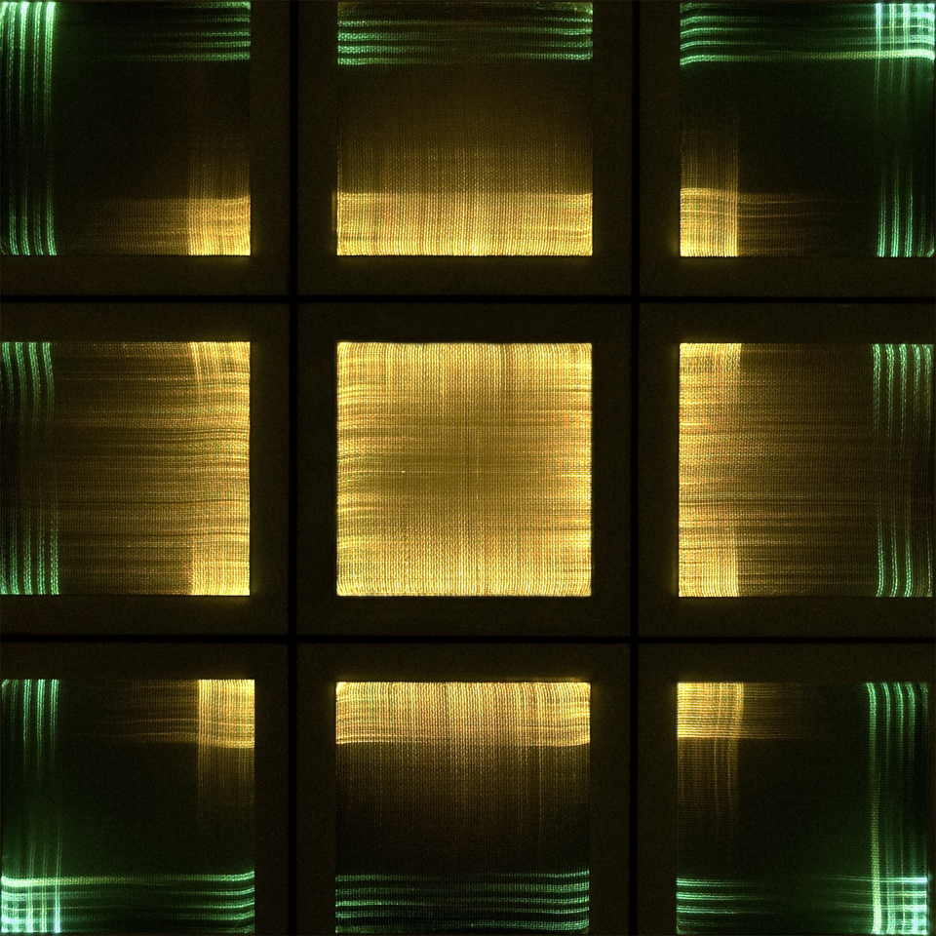
Visual Art Example - Fiber Optic Tapestry
Notes:
Participants address the Fiber Optic Tapestry by tweeting #optictapestry and a primary
color—the tapestry displays the colors in algorithmically-determined patterns.

Slide 88
Design Considerations

Slide 89
Design Considerations
As a designer - have a goal
Think about type of visualization that is suitable:
exploratory vs. explanatory
informative vs. persuasive vs. visual art
What information should they be able to learn from this visualization?
What point or message are you trying to convey?
you should be open to iteration and evolution, serendipity, and the paths that new insight may reveal

Slide 90
Design Considerations
it is important to put yourself in the shoes of your reader
Take into consideration the unique viewpoint that he will bring with him.
Your success is measured by your reader’s success.

Slide 91
Design Considerations
Remember that with visualization,
you are communicating with the reader
Need to consider how the information is encoded, so that reader can decode correctly and receiver your message
Simplify your explanations until message is clear
not the same as simplifying ideas
if you can't find a simple explanation, you may yourself not understand the data

Slide 92
Design Considerations
Reader is not you!
do not make assumptions without considering the audience
consider the demographic group / experience / knowledge / …
Also consider social context:
What do colors mean?
Which direction it the reader used to reading in?
Which icons is she familiar with?

Slide 93
Design Considerations
The key questions to ask here are ones like:
What information does my reader need to be successful?
How much detail does she need?
How long does she have to make it effective?

Slide 94
Design Considerations
Lastly, consider the data itself:
Is it a time-series? A hierarchy?
How many dimensions does it have? Which are the most important ones?
What sort of relationships do they have (e.g., one-to-one or many-to-many)?
How variable are they?
Are the values categorical? Discrete or continuous? Linear or non-linear? How are they bounded?
How many categories are there?

Slide 95
Tools of the Trade

Slide 96
Tools of the Trade
MS Excel
Tableau
Google Chart Tools
MATLAB
Python + matplotlib or plot.ly or chaco
D3
Processing
…(many others)

